Slide 1

What’s the Story About Agile Data
How Agile lost the data war, and what we need to do about it @t_magennis or troy.magennis@focusedobjective.com

Slide 2

Agile/Waterfall
Dirty Data Done Dirt Cheap
My Album
Nah, But I am from Australia like AC/DC

Slide 3

TROY MAGENNIS
TROY’S MOM
Data
Using Data
My Book
Nah, but I did work on Navy electronics equipment
Apologies to: L. David Marquet

Slide 4

Make Data Awesome
Experiment
Chart Data
Using Data
DATA
Continuously
My Circular Quadrant
Use Data Safely
Nah, but I am a consultant
Apologies to: Joshua Kerievsky

Slide 5
I’m really just known for
SPREADSHEETS

Slide 6
Let’s start with something we all agree about
#NoEstimates

Slide 7


How about…
#NoAbsolutes
No Never Always
Why When How
#Experiments
#DataOrItDidn’tHappen

Slide 8
Data is beautiful
Data is a people problem
Price we pay for Predictability
How we got Forecasting wrong
Story points vs Throughput throwdown
Devastating Impact of Dependencies
Teams could/should be larger

Slide 9
Todays Challenges
1. Data: it isn’t charts – it’s decisions
2. Focus more on system problems, less on local ones
3. Focus more on start dates, less on end dates
4. Balancing value and innovation against “predictability”
5. Teams should be larger – paralyzed by dependencies

Slide 10
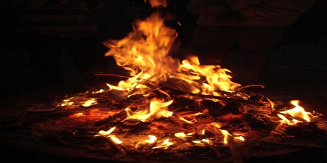
Boring -> Beautiful -> Action
Goal of slide: Introduce “stories” as the way humans share knowledge. How we engage in observation and recollection as a way to improve
https://commons.wikimedia.org/wiki/File:Campfire_Pinecone.png
Attribution: Emeldil at English Wikipedia

Slide 11
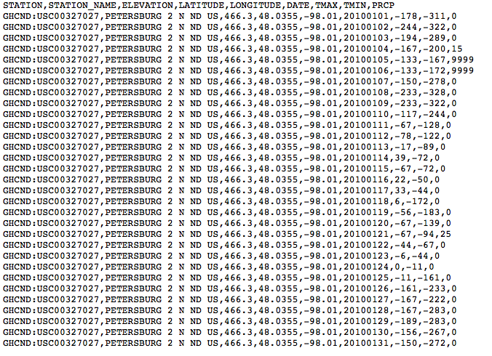

Goal of slide: Show how data alone is boring. Experts needed to interpret the story.

Slide 12
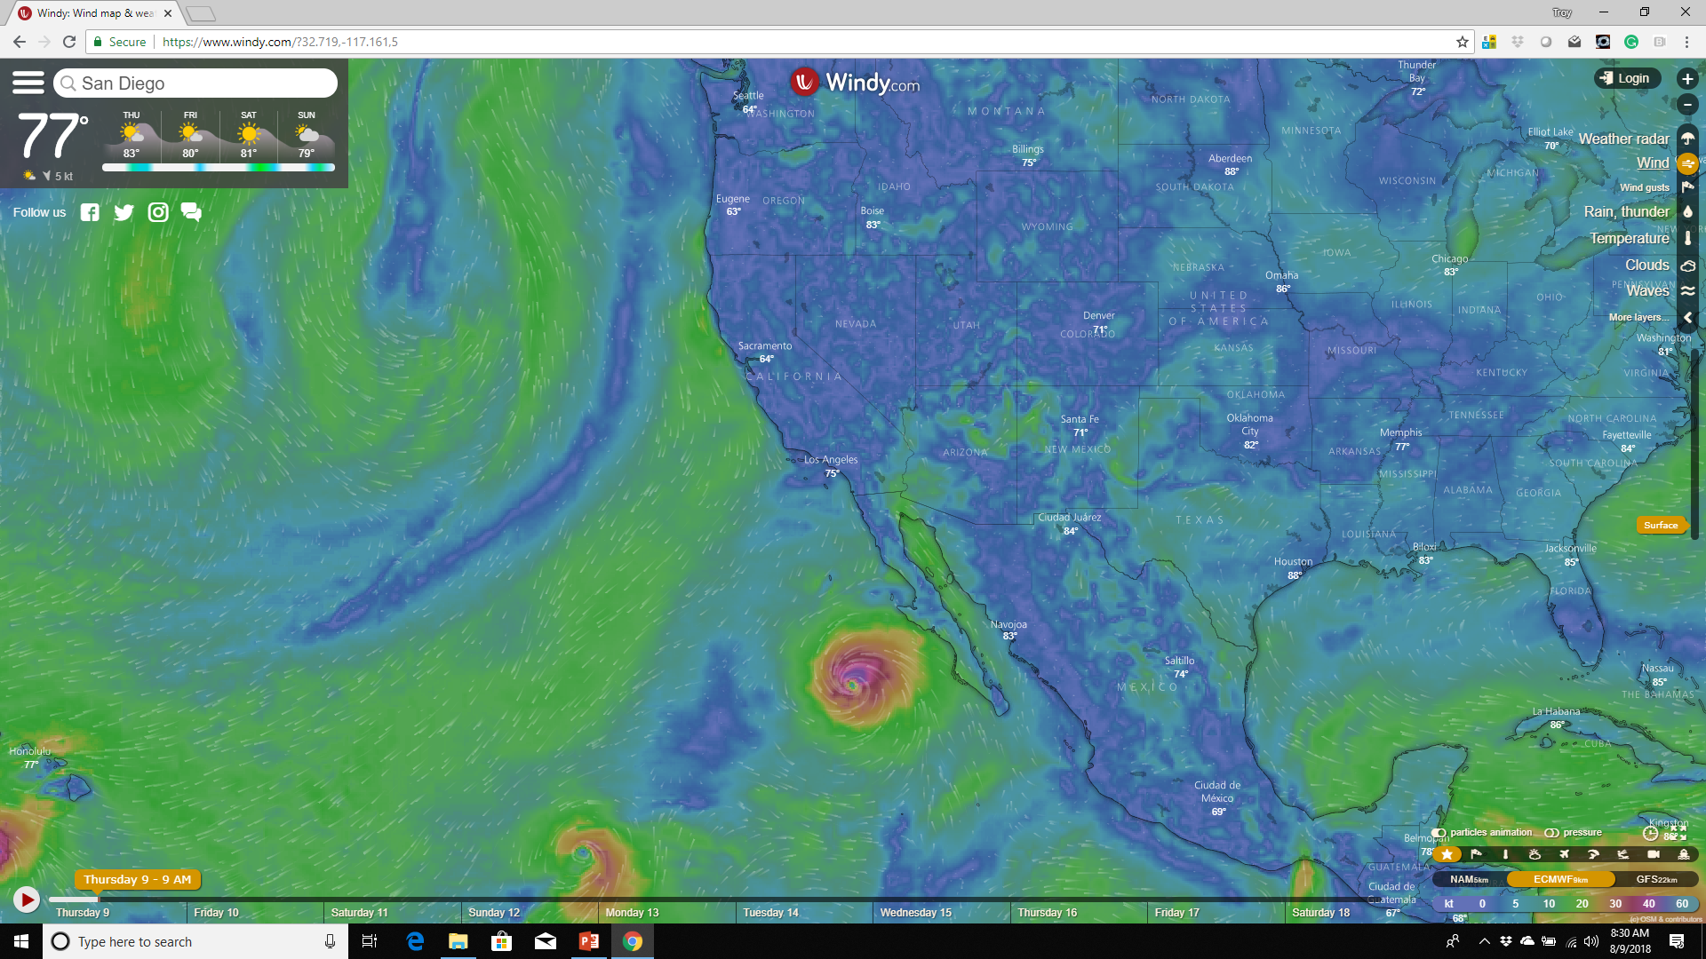
Goal of slide: Show how movement and animation help see change over time and make an immersive environment.
Windy.com

Slide 13


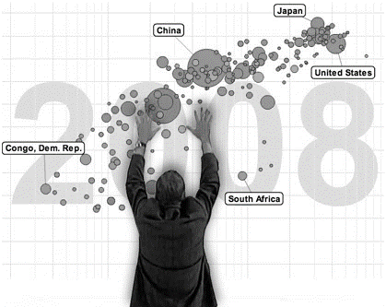
Hans Rosling - 27 July 1948 – 7 February 2017
Goal of slide: Introduce data hero 2. Hans Rosling who was tragically lost last year to Cancer.
He took on the challenge of changing the world by make Global Health data available.

Slide 14
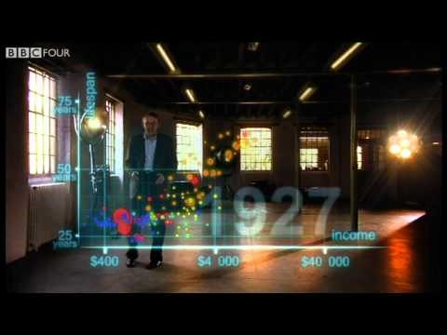
NOTE: Replace with embedded video in case of network issues

Slide 15
Agile Community Call to Action
Having the data isn’t enough
You have to tell the story that leads to the right action

Slide 16
Data is a People Problem

Slide 17
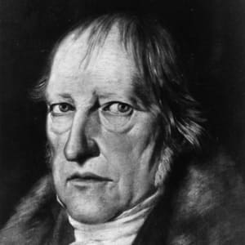
“We learn from history, that we do not learn from history.”
Friedrich Hegel

Slide 18
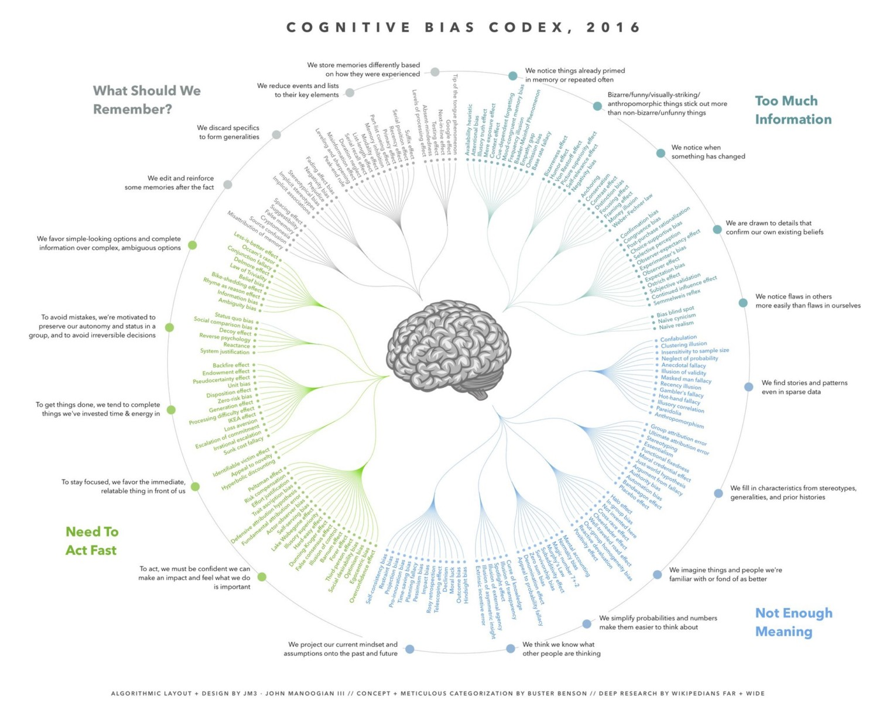

Slide 20
Use historical data alone and we might be wrong due to context
Use experience alone and we might be wrong due to cognitive bias

Slide 21
ALWAYS
Data + Conversation

Slide 22
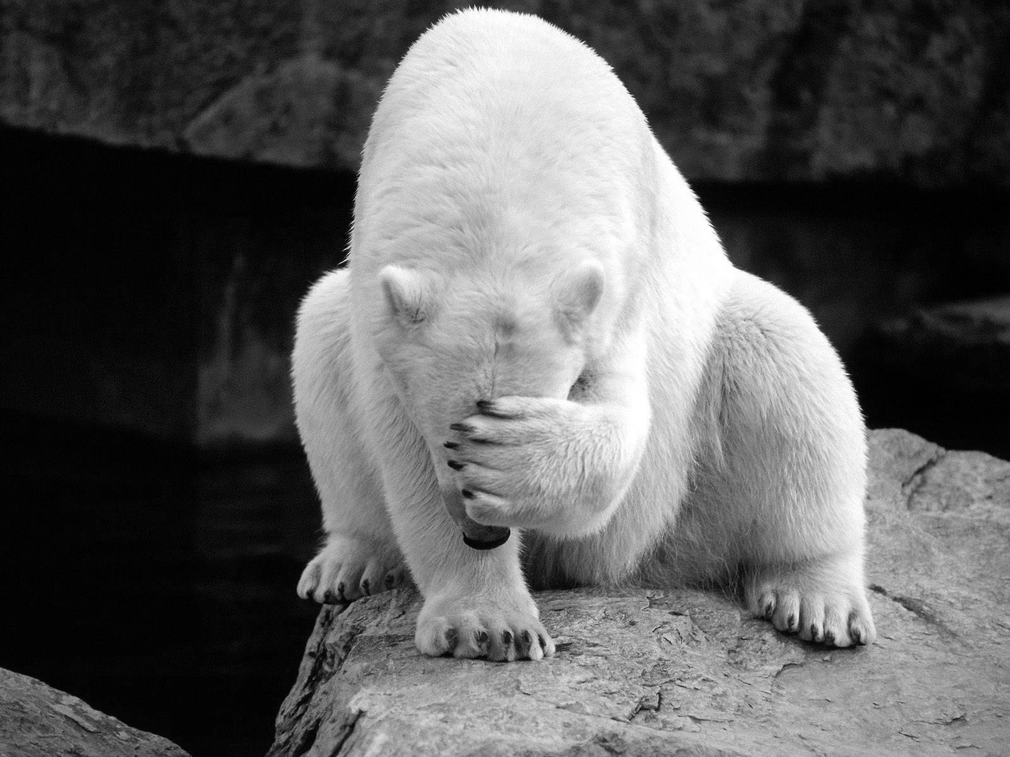
Fastest way to get crappy data is to embarrass people

Slide 23
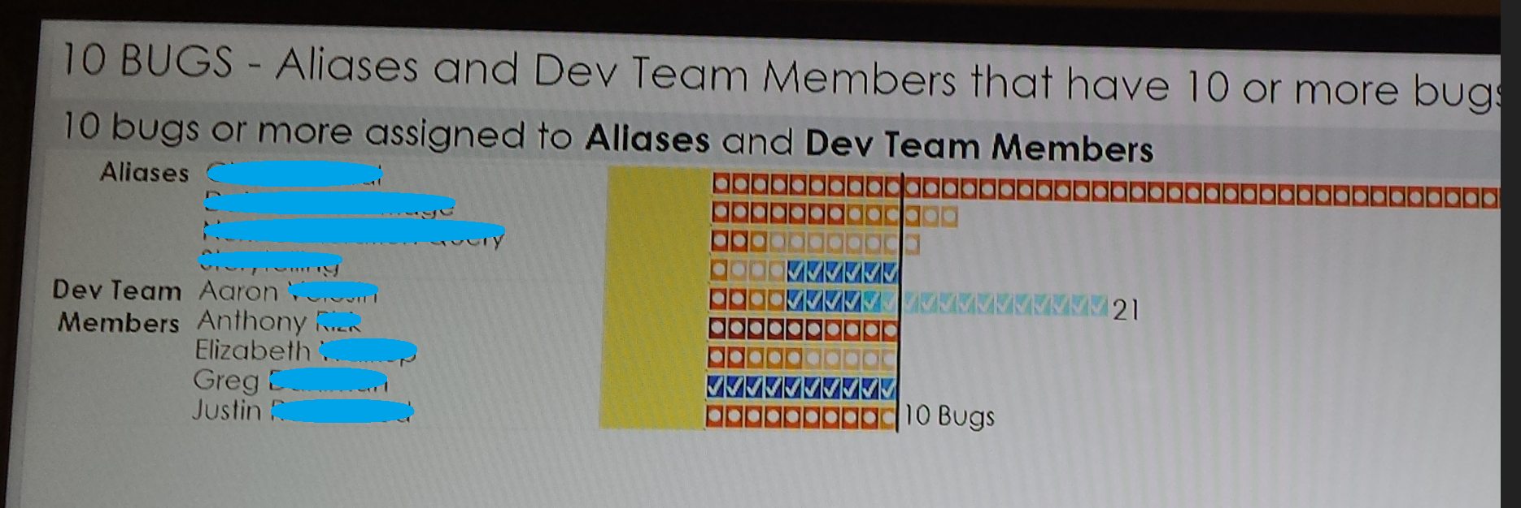

Slide 24

Fastest way to destroy the utility of historical data is to make people unsafe

Slide 25
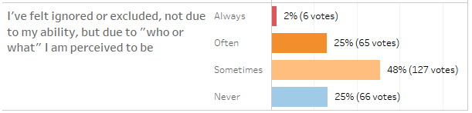
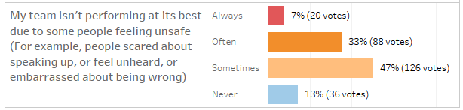
75% people feel ignored at times
87% teams could be performing better

Slide 26
Agile Community Call to Action
We need to find safer ways to capture and
utilize data from teams and organizations.
safer = better data and happier people

Slide 27
We pay too high a price for “predictability”

Slide 28
Where is our “analytical” effort spent?
Goal of slide: Show how our intensity towards status reporting is stealing from where big-bang-for-the-buck analytics would help.
Now
Goal
“Which one moves the needle most”
Selection / Prioritization
Lots
Status / In-progress
Customer Validation (Impact)
Little

Slide 29
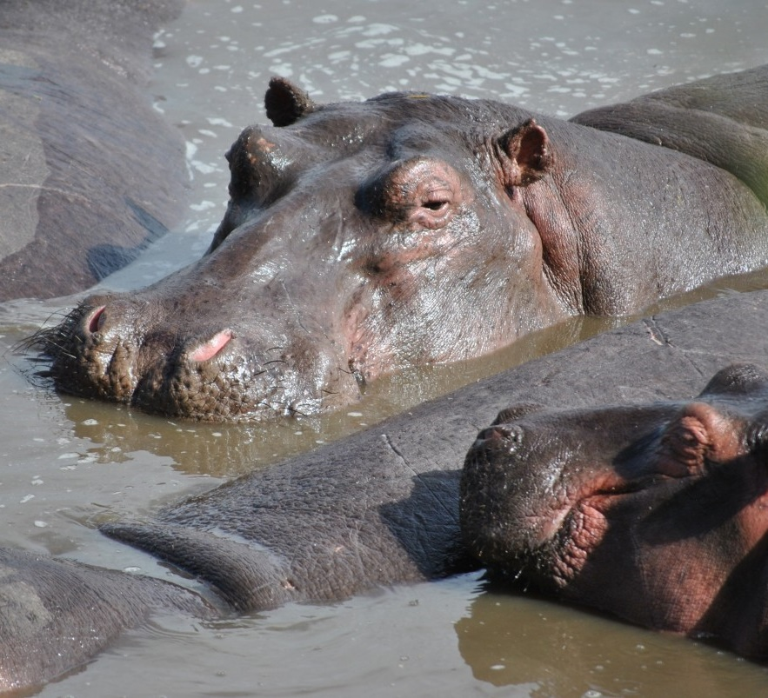
Why are “we” last to know?
ME
Get status more often
Cherry pick senior staff
Insist on More planning
Yell during meetings

Slide 30
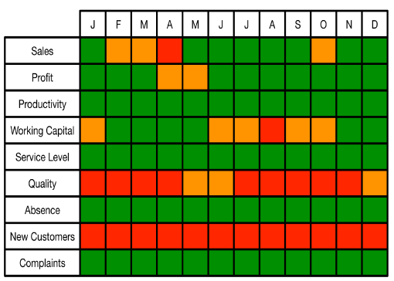
“You can’t do anything with status except worry”
Tony Grout

Slide 31
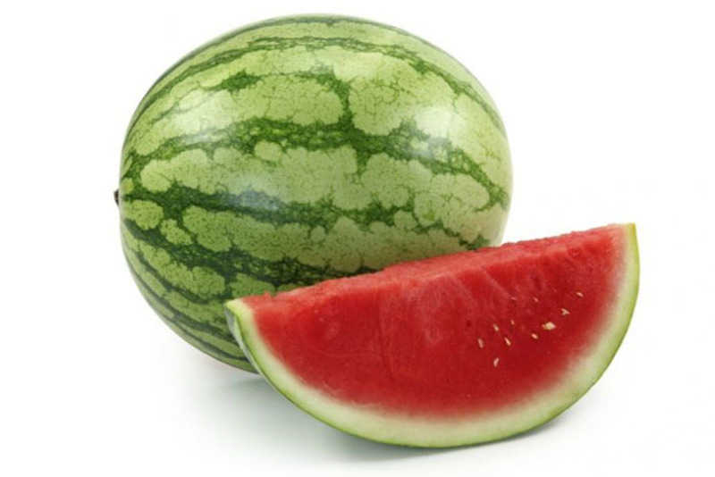
“Watermelon Status – Green on the outside, Red on the inside”
Blockbuster extinction

Slide 32
Data is a People Problem

Slide 33

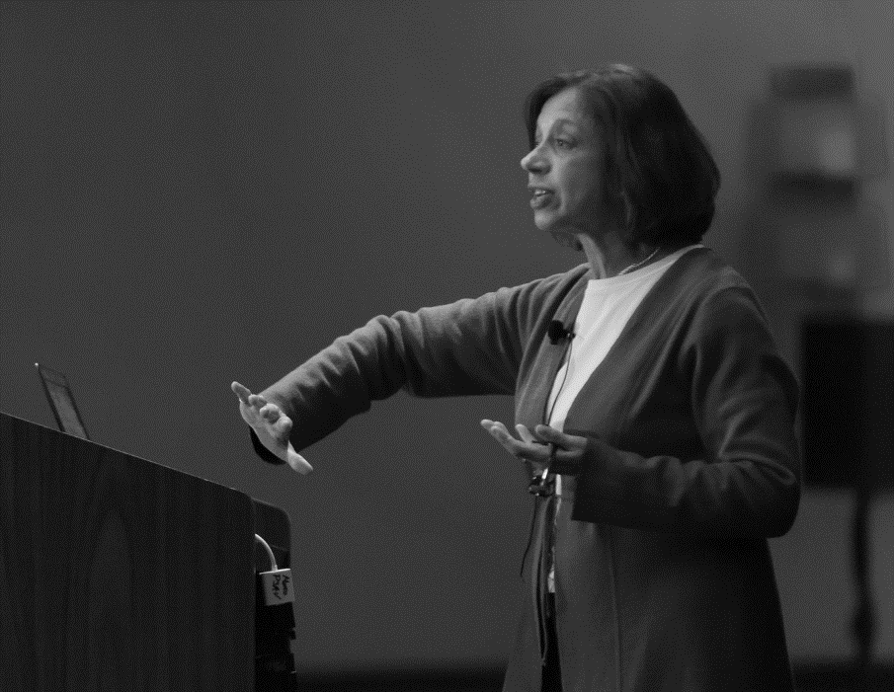
Goal of slide: We mine value.
…the price we pay for the potential of true novelty and creativity is uncertainty.
— Alicia Juarrero
https://pxhere.com/en/photo/1105723

Slide 34
Goal of slide: We mine value.
Would you trade…
2x to create for
10x customer value (potentially)

Slide 35
Agile Community Call to Action
We need to find better ways to measure outcome rather than output
We need to balance our predictability expectations with creativity and novelty

Slide 36
New information
New information
New information
Start
Done
Uncertainty

Slide 37
Agile Community Call to Action
We need to incorporate New Information faster
Deployment ENDS speculation
(do this more often)

Slide 38
Yeah, but how long will THIS feature take?

Slide 39
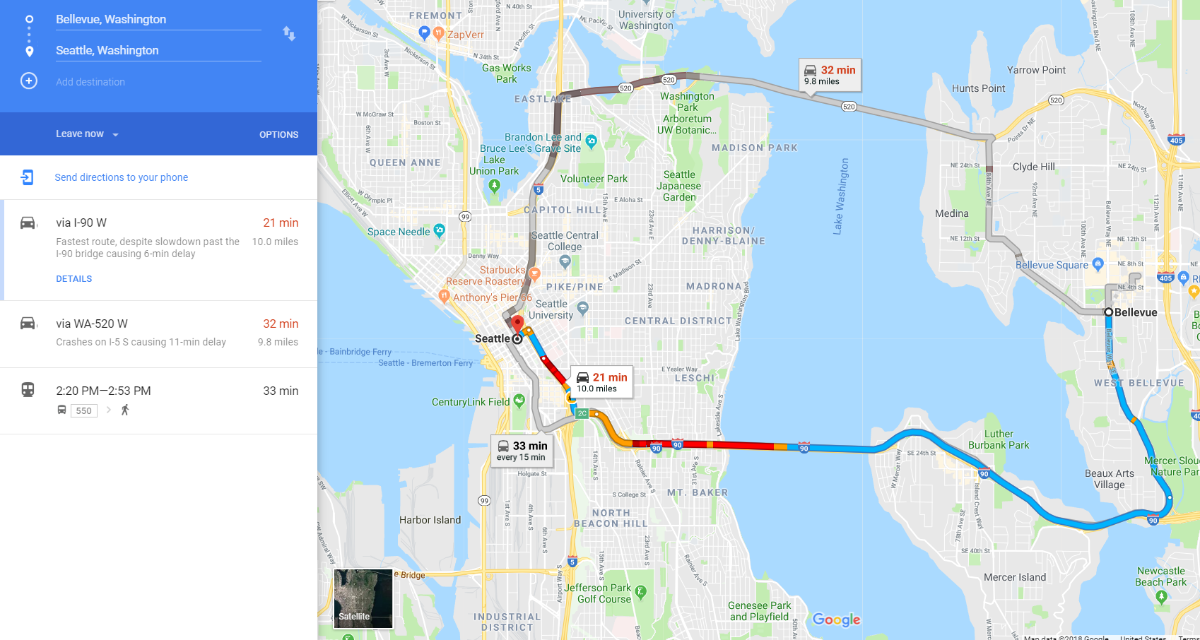
Duration, not ETA
Until you start, then continuously updated with Time Remaining
Multiple options

Slide 40
Contrast Software Planning to Google Maps
If you currently…
Consider doing…
Give one forecast even though multiple approaches considered
Give a calendar date for undefined “complete” & “start”
If the original date is in doubt we find out near the end
Give multiple options of investment and implementation
Give a duration and define what started & complete means
If the original date is in doubt, know earlier and react faster

Slide 41
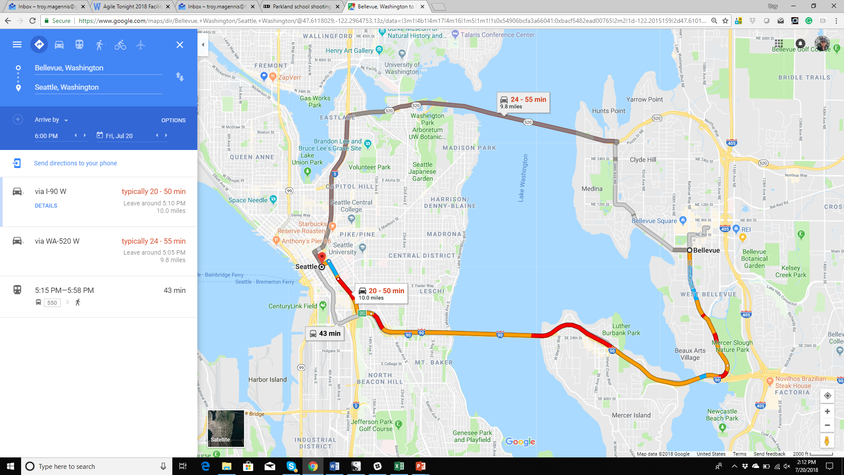
Forecasting is about knowing when to START
#1 Reason we miss deadlines
We START too late

Slide 42
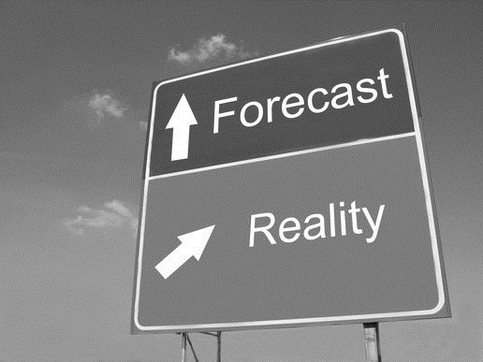
You don't do forecasts and estimates to know you are right; you do forecasts and estimates to detect you are wrong

Slide 43
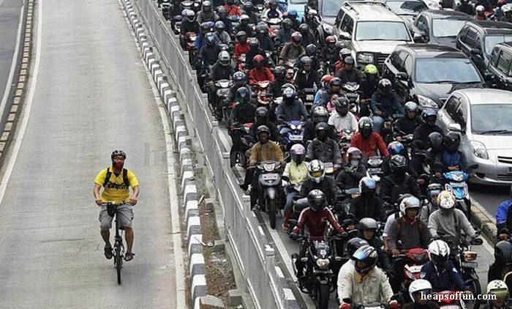

Slide 44
Story Points or Throughput?

Slide 45

1 point
13 points
https://pxhere.com/en/photo/775063

Slide 46
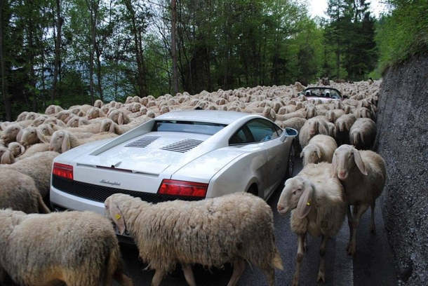

Slide 47

1 point
Impediment / dependency
Impediment / dependency
13 points
https://pxhere.com/en/photo/775063

Slide 48
1 point
Impediment / dependency
Impediment / dependency
13 points
https://pxhere.com/en/photo/775063

Slide 49
13 points
1 point
20 Mins
20 Mins

Slide 50
Story Points or Item Count Forecast Better?
Story Points Work Better…
Item Count Works Better…
Development Time > Delays
Few Dependencies
Flexible capacity / Dedicated staff
Delays > Development Time
Many Dependencies
Constrained capacity / Shared staff
Why?
Why?
Development time dominates the lead time to release
Error introduced by assuming all similar sized items can be huge
Delay time(s) dominates the lead time to release
Error introduced by story point size estimates can be huge

Slide 51
Experiment
Hide last “months” data
See if you can predict where you are now

Slide 52
Yeah, but How much data do I need?

Slide 53
What is the chance the next sample tells me something new about the actual data?
At 10 samples, 18% (or 9% for “worse”)
At 20 samples, 10% (or 5% for “worse”)

Slide 54

Never marry before 7
Marry the best of the first 11

Slide 55
When forecasting using historical velocity or throughput data
Use the most recent 10 samples and delete the rest
Stale data erodes context

Slide 56
Dep
ende
ncies

Slide 57
Joe
Joy
Jack
Janet
1 in 16
 |  |  | ON-TIME
 |  |  | DELAYED
(Seated on-time)
15 in 16
(Seated late)

Slide 58
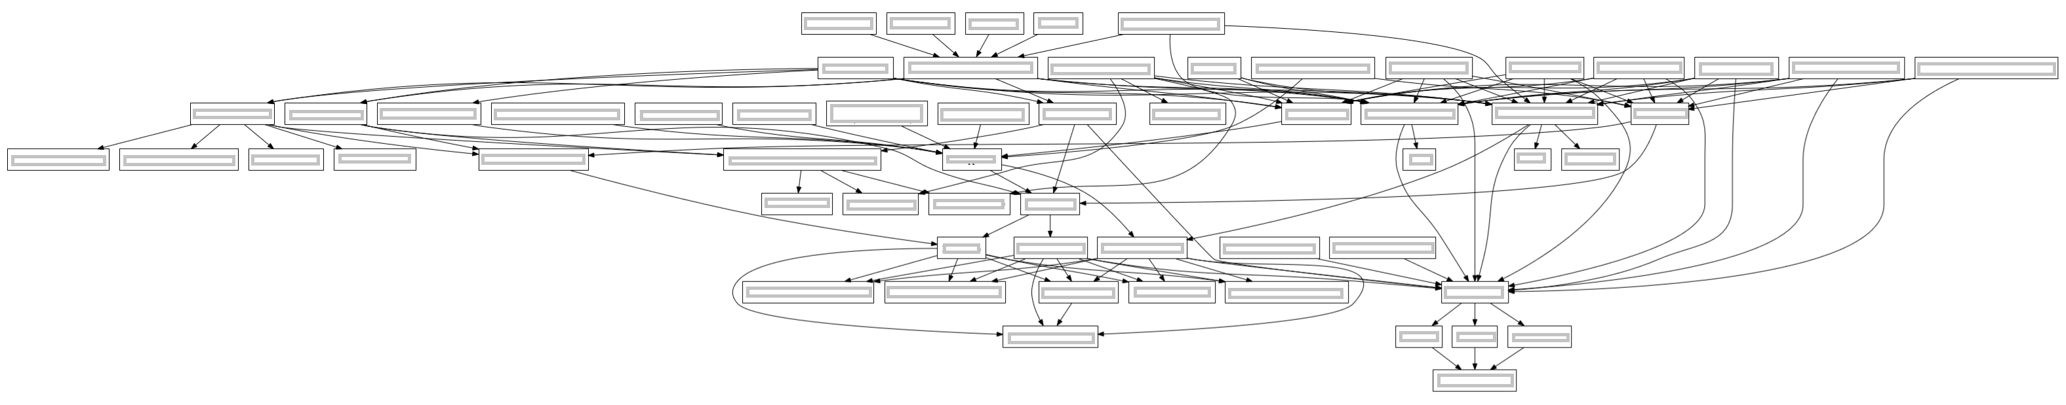
1
2
3
4
5
6
7
Team Dependency Diagram
@greening

Slide 59
Chances at least one team not delayed
1 in 2^{n} ^{or}
1 in 2⁷
^{or}
1 in 128

Slide 60
7 dependencies
1 chance in 128

Slide 61
6 dependencies
1 chance in 64

Slide 62
5 dependencies
1 chance in 32

Slide 63
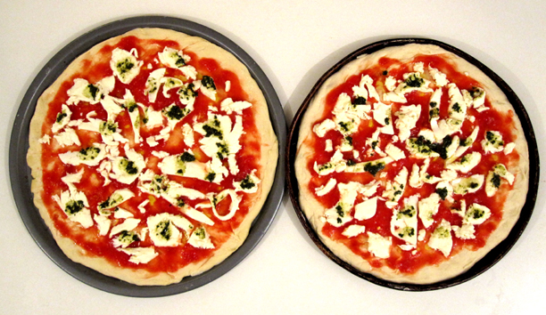

Slide 65
Experiment
Organize to minimize dependencies
Better?

Slide 66
Agile Community Call to Action
We need to visualize and manage dependencies
We need to minimize dependencies
We need to talk about tactical larger teams

Slide 67
OK, Brace Yourself
We NEED to compare teams
Common Cause vs Special Cause
Everyone vs Just Us

Slide 68
Throughput per week for 100 teams
Oops
NOTHING you can estimate poorly will be as DAMAGING as system issue
Oops

Slide 69
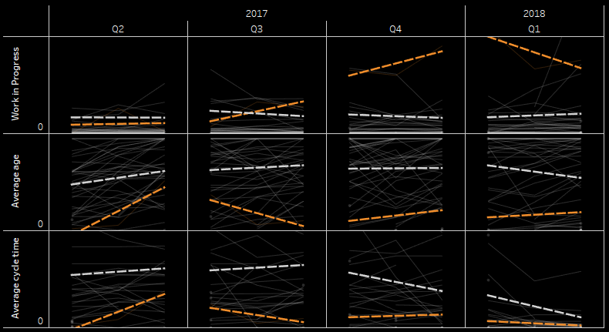


All Teams Trend
Our Teams Trend

Slide 70
Data is a People Problem

Slide 71
Thank you….
Stay sandy San Diego…….
@t_magennis
Troy.Magennis@focusedobjective.com
Bit.ly/SimReources

